Slide 1


Spark Interview Questions Spark SQL

Slide 2
What is Spark SQL
Spark SQL is a module in Spark which integrates relational processing with Spark’s functional programming API.
It supports querying data either via SQL or via the Hive Query Language.
For those of you familiar with RDBMS, Spark SQL will be an easy transition from your earlier tools where you can extend the boundaries of traditional relational data processing.
Spark SQL integrates relational processing with Spark’s functional programming.
At the same time, it provides support for various data sources and makes it possible to weave SQL queries with code transformations thus resulting in a very powerful tool.

Slide 3
What is Spark SQL
The following are the four libraries of Spark SQL.
Data Source API
Data Frame API
Interpreter & Optimizer (Catalyst)
SQL Service

Slide 4
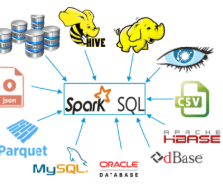
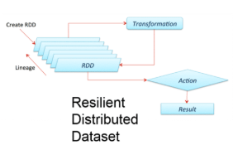


Spark SQL
DataSource API
RDD
Data Frame API
Interpreter & catalyst Optimizer
Named Columns
Spark SQL Service
Results

Slide 5
Thanks and do subscribe to my channel

